Slide 1
Ensemble Learning

Slide 2
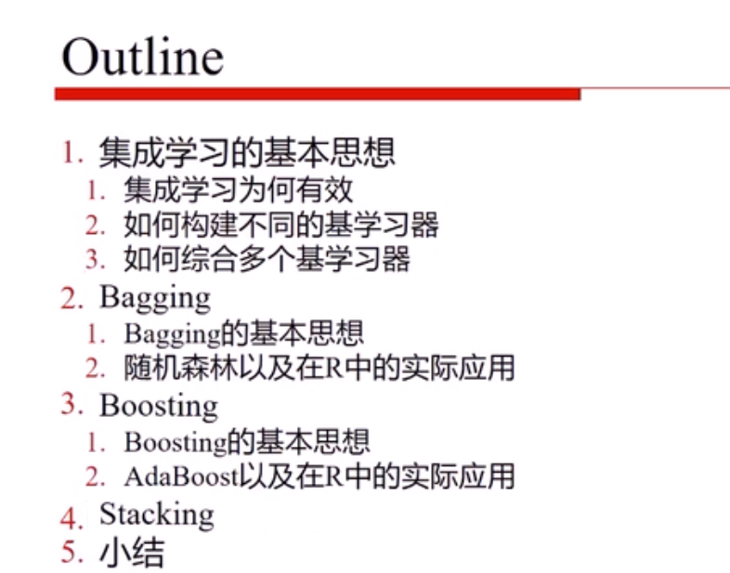

Slide 3




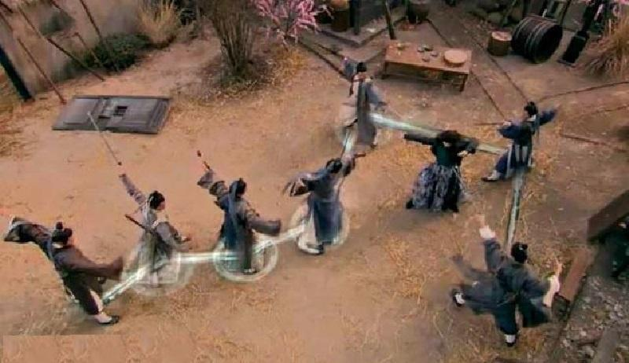
Real World Scenarios
VS.

Slide 4


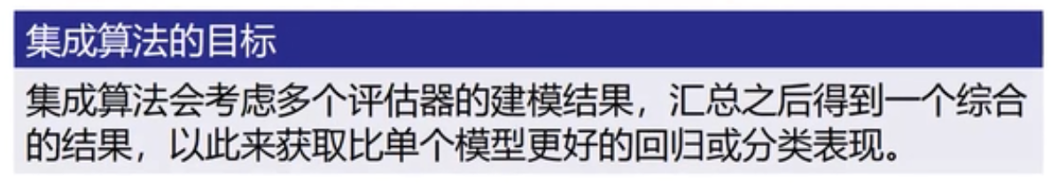
Real World Scenarios

Slide 5
What is ensemble learning?
Many individual learning algorithms are available:
Decision Trees, Neural Networks, Support Vector Machines
The process by which multiple models are strategically generated and combined in order to better solve a particular Machine Learning problem
Motivations
To improve the performance of a single model
To reduce the likelihood of an unfortunate selection of a poor model
Multiple Classifier Systems
One idea, many implementations
Bagging
Boosting

Slide 6
Algorithm Hierarchy
Machine learning
Supervised learning
Classification
Semi-supervised learning
Unsupervised learning
Clustering
Single algorithms:
SVM,DT,NN
Ensemble algorithms
Boosting
Bagging

Slide 7
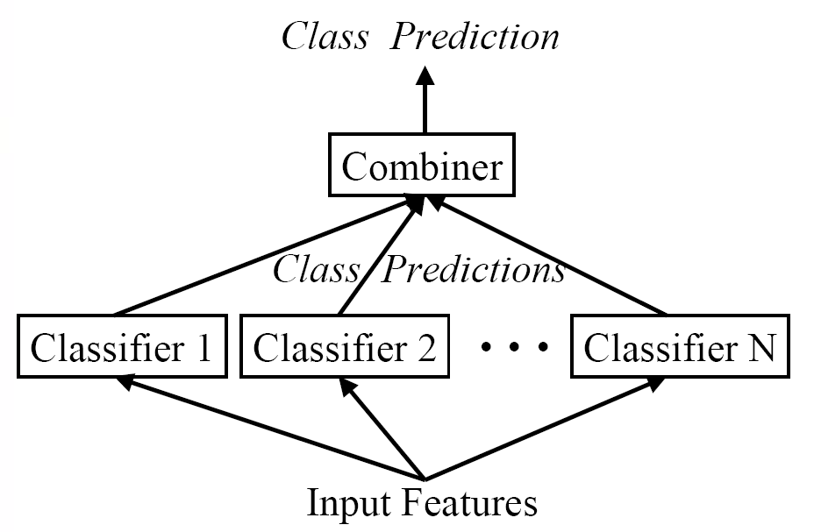
Combination of Classifiers

Slide 8
Model Selection
Notes:
每次只70%拿出来所有训练样本，进行训练

Slide 9
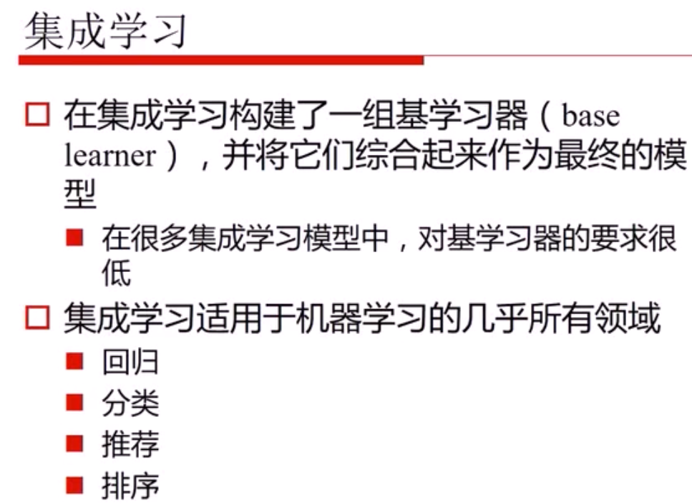

Slide 10
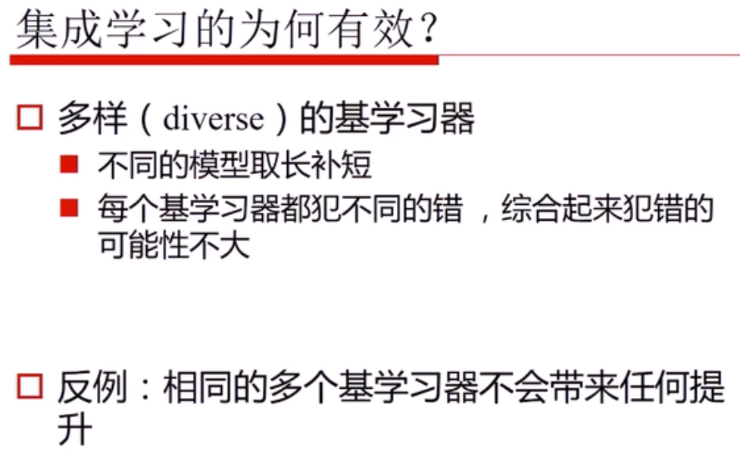

Slide 11
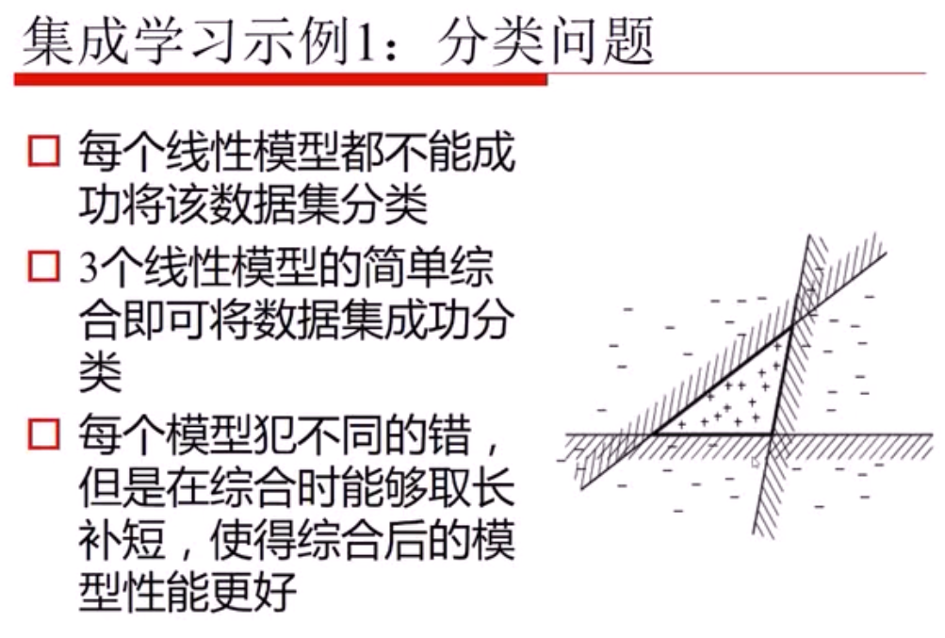
Notes:
投票，3个都正确
其他，错误，只有1，或者2个投票支持

Slide 12
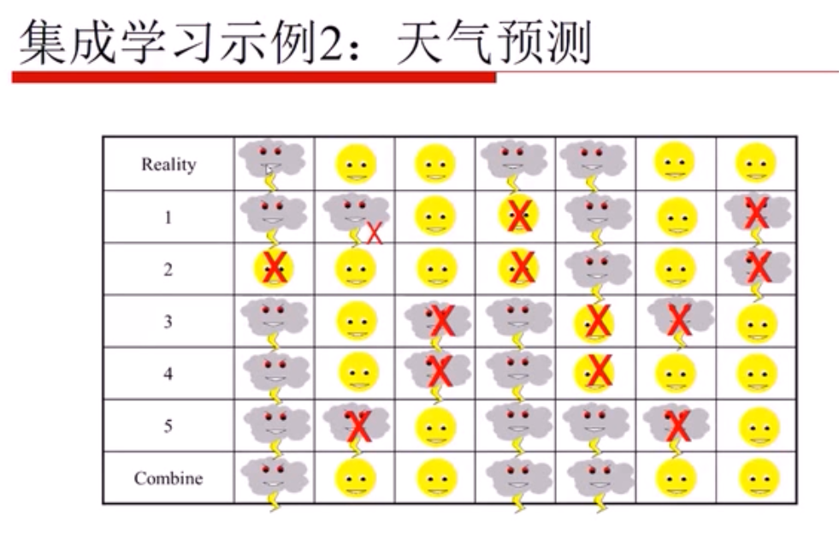

Slide 13
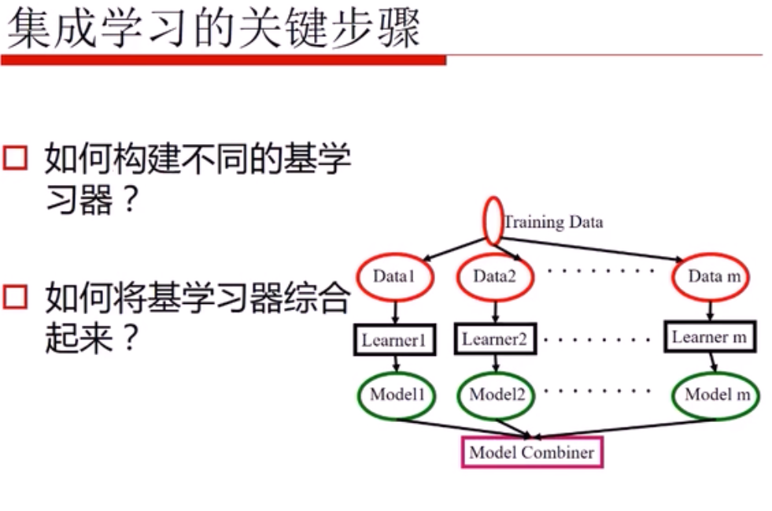

Slide 14
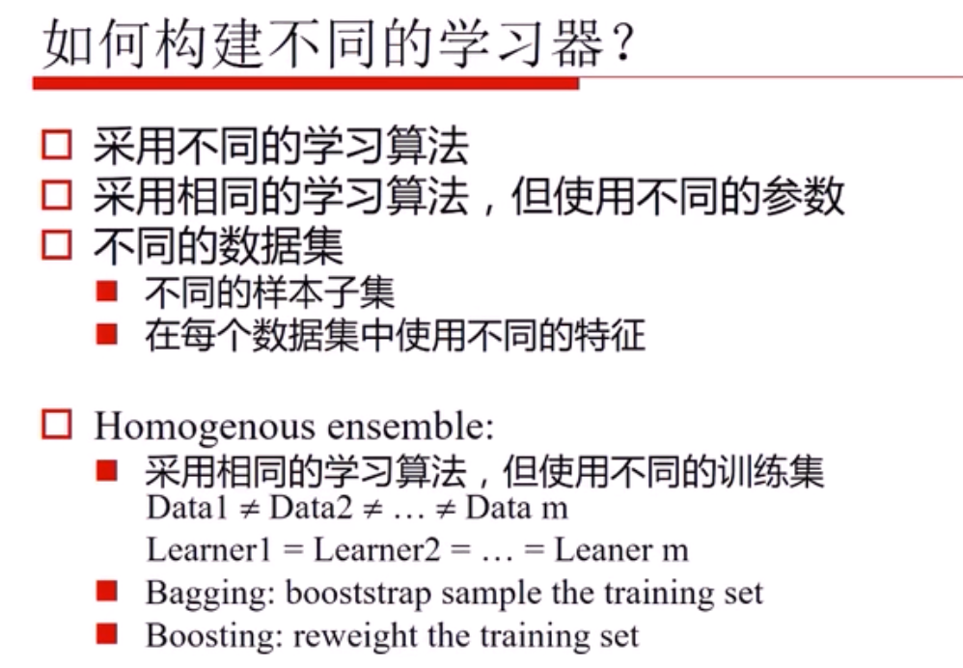

Slide 15
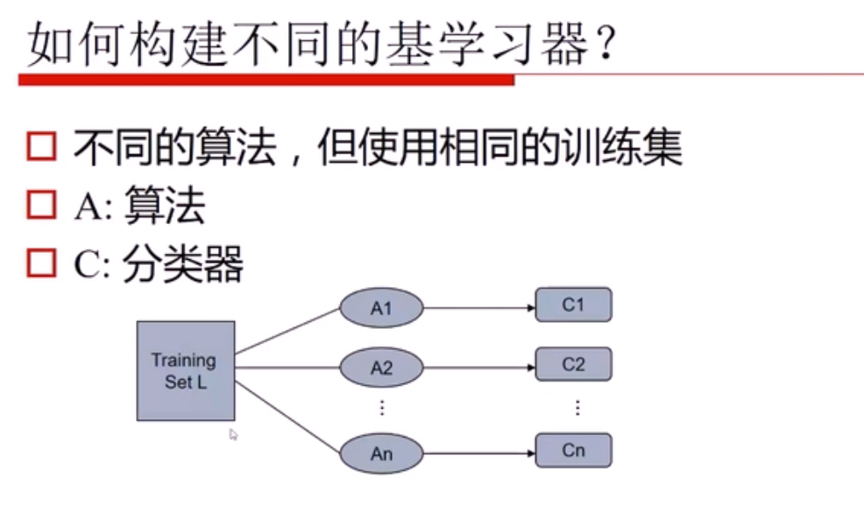

Slide 16
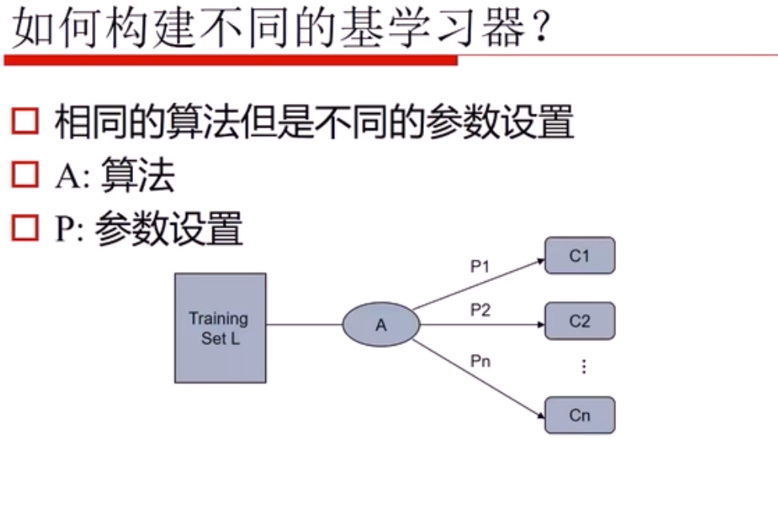

Slide 17
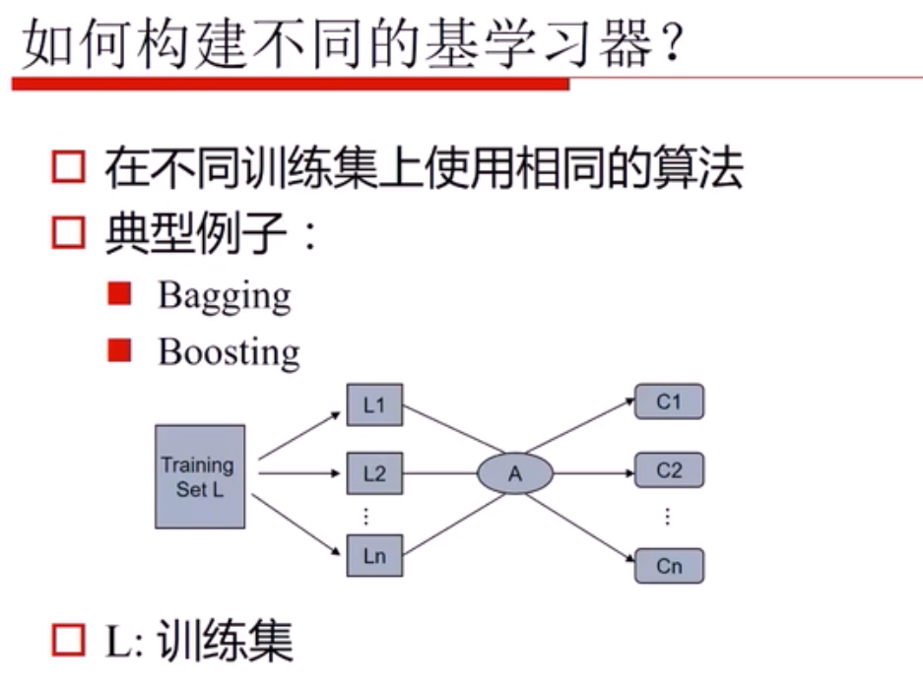

Slide 18
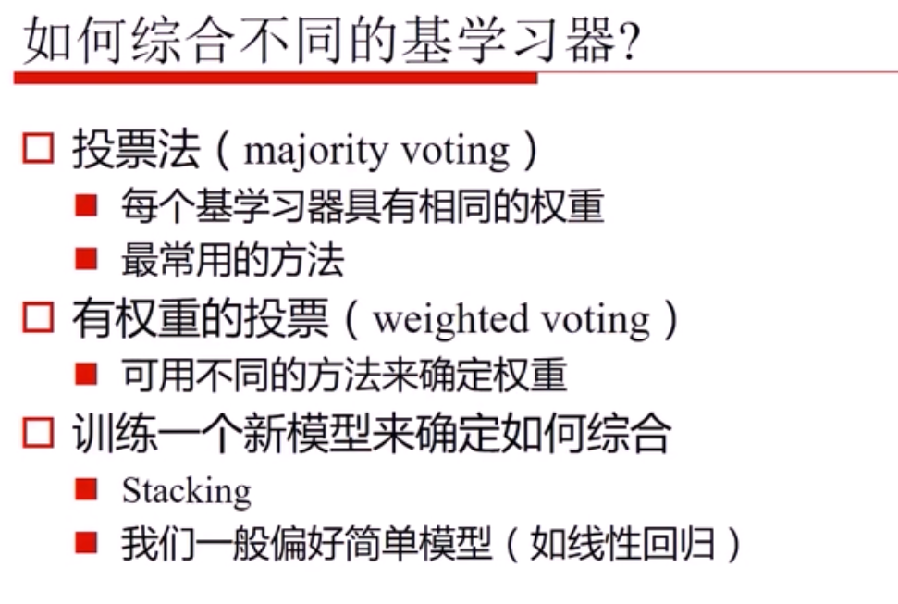

Slide 19
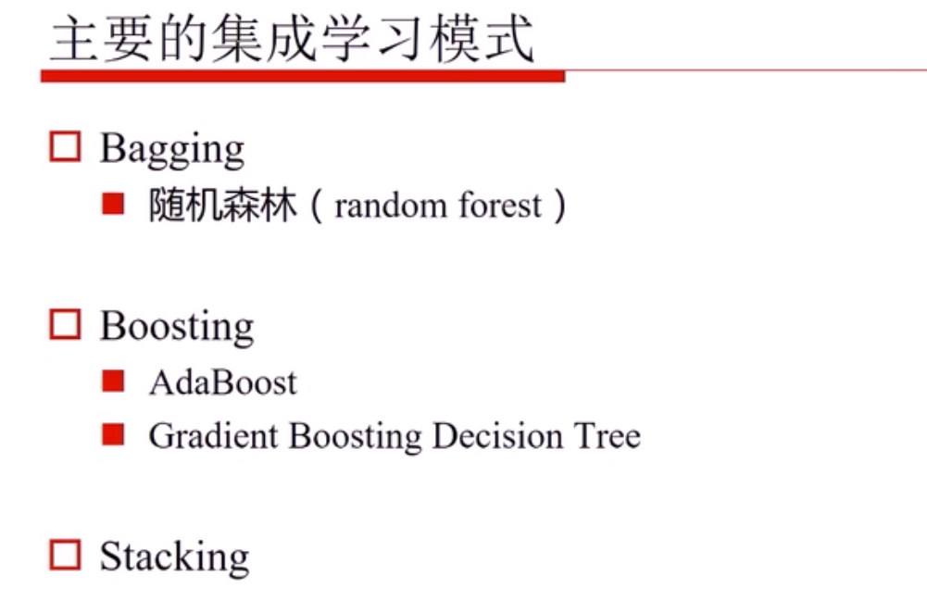
Notes:
Bagging算法 （英语：Bootstrap aggregating，引导聚集算法），又称装袋算法

Slide 20
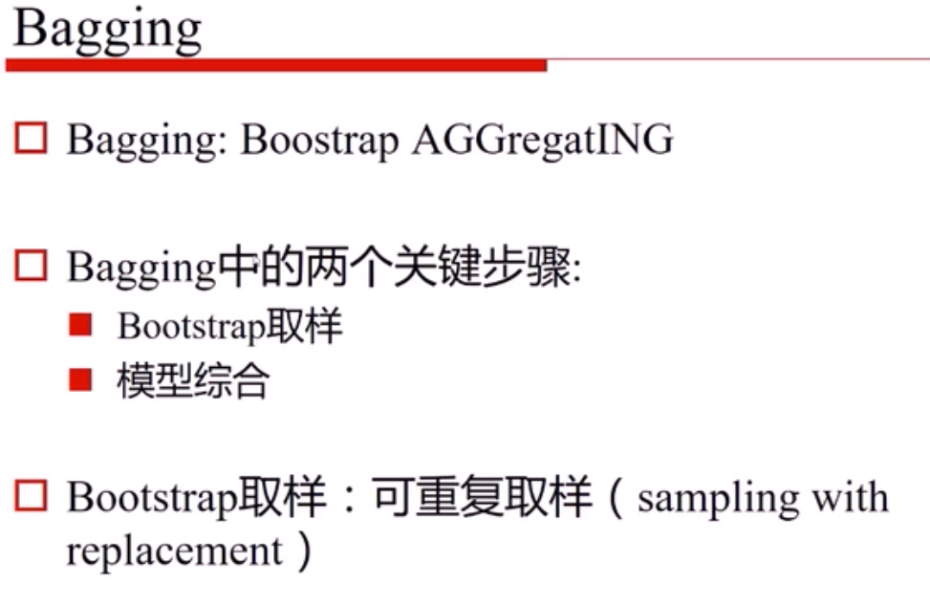

Slide 21
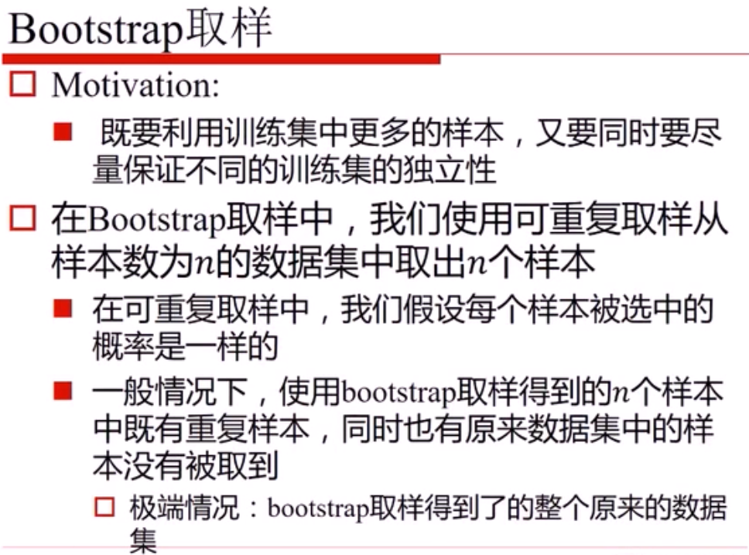
Notes:
有放回的采样 可重复取样
bootstrap英['bu:tstræp]美[ˈbutˌstræp]
v.独自创立; 靠一己之力做成; 附属于; 与…相联系;
Bagging算法 （英语：Bootstrap aggregating，引导聚集算法），又称装袋算法，是机器学习领域的一种团体学习算法。最初由Leo Breiman于1996年提出。Bagging算法可与其他分类、回归算法结合，提高其准确率、稳定性的同时，通过降低结果的方差，避免过拟合的发生。

Slide 22
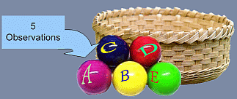
Bootstrap Samples
Sample 1
Sample 2
Sample 3
Notes:
有放回的采样 可重复取样
bootstrap英['bu:tstræp]美[ˈbutˌstræp]
v.独自创立; 靠一己之力做成; 附属于; 与…相联系;

Slide 23
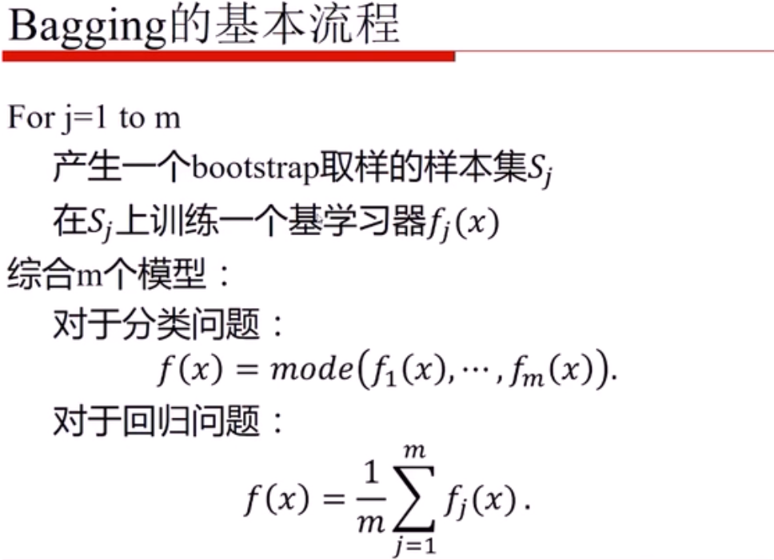
Notes:
Bagging算法 （Bootstrap aggregating）

Slide 24
Bagging
D
Bootstrap
D₁
Train
D₂
Learner
…
D_{k}
0
1
..
1
C₁
Voting
Test
1
C₂
…
x
C_{k}

Slide 25
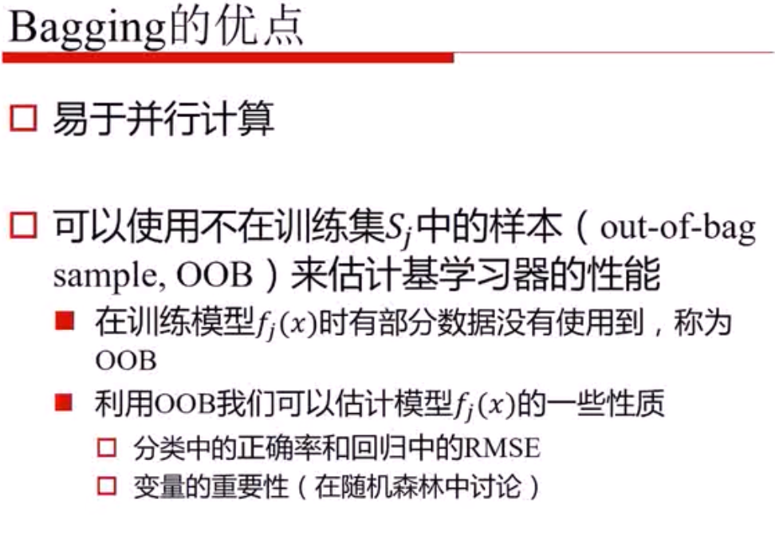

Slide 26
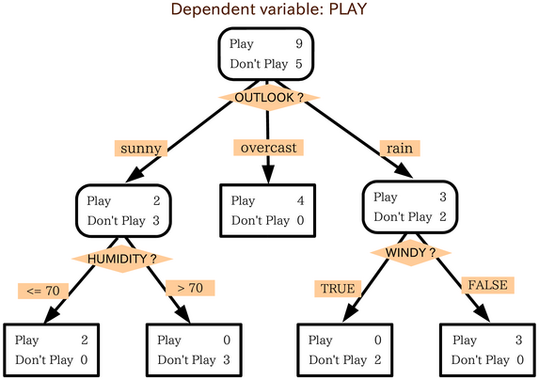
A Decision Tree

Slide 27
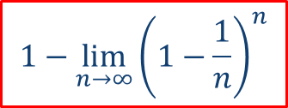
Random Forests
Developed by Prof. Leo Breiman
Inventor of CART
www.stat.berkeley.edu/users/breiman/
Breiman, L.: Random Forests. Machine Learning 45(1), 5–32, 2001
Bootstrap Aggregation (Bagging)
Resample with Replacement
Use around two third of the original data.
A Collection of CART-like Trees
Binary Partition
No Pruning
Inherent Randomness
Majority Voting
$$1−\lim_{n→∞}{{\left(1−\frac{1}{n}\right)}^{n}}$$
Notes:
2/3样本被选中
500 到 5000

Slide 28
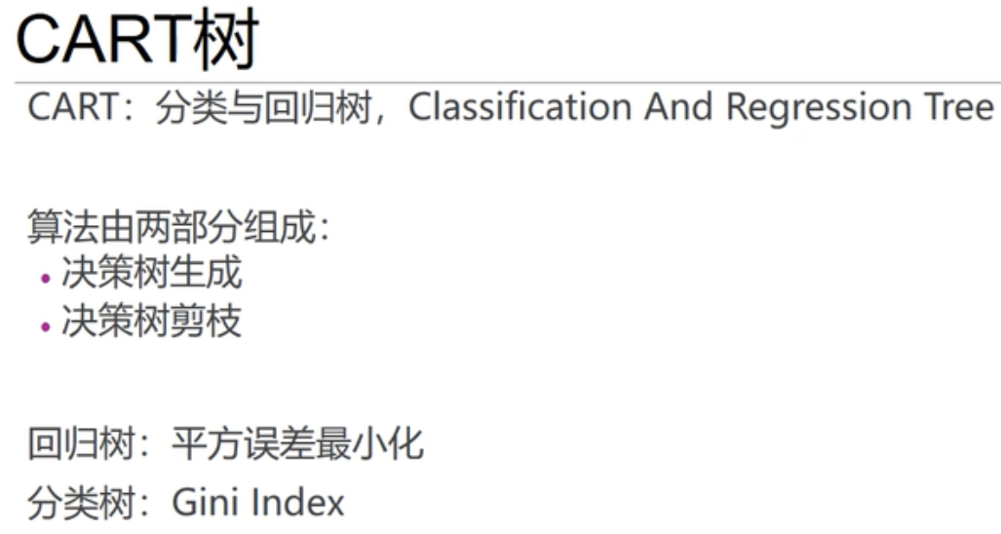

Slide 29
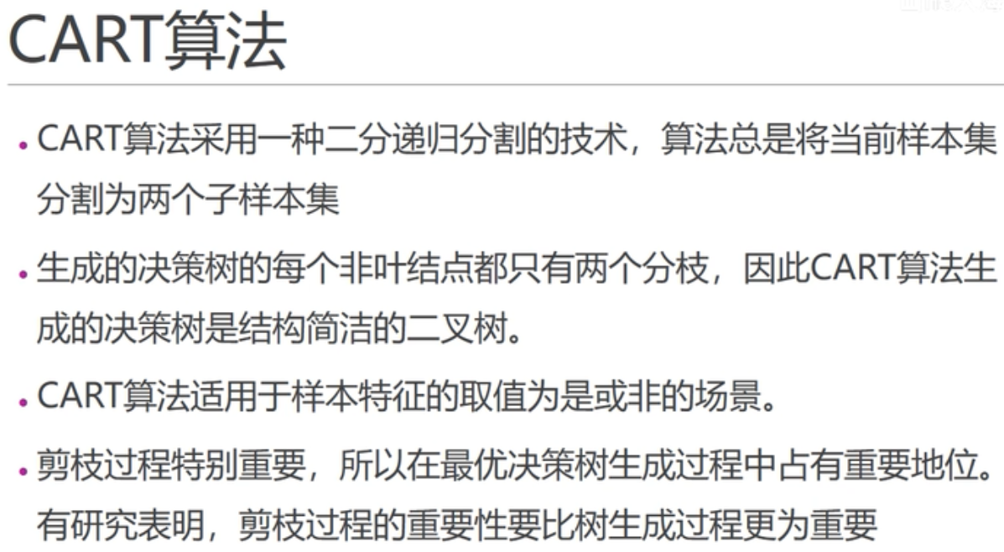

Slide 30
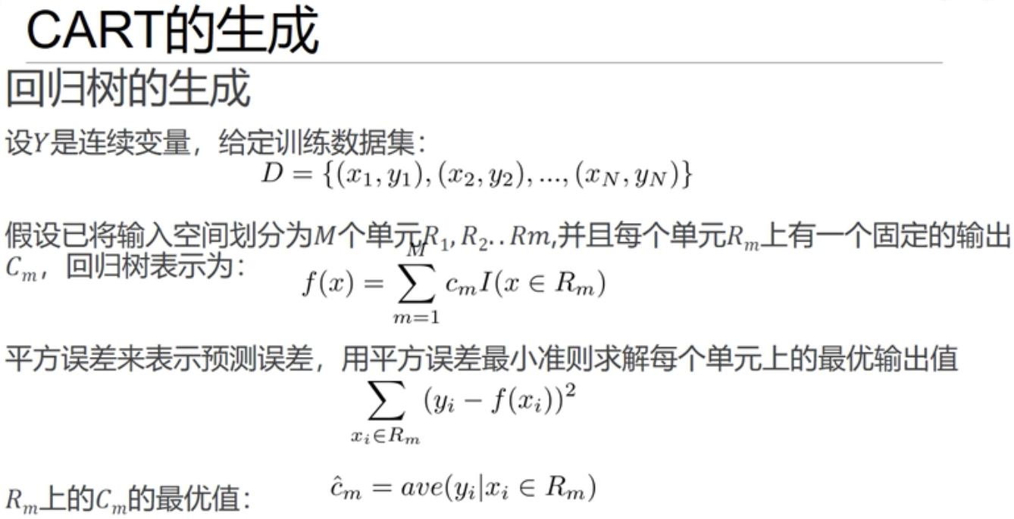

Slide 31
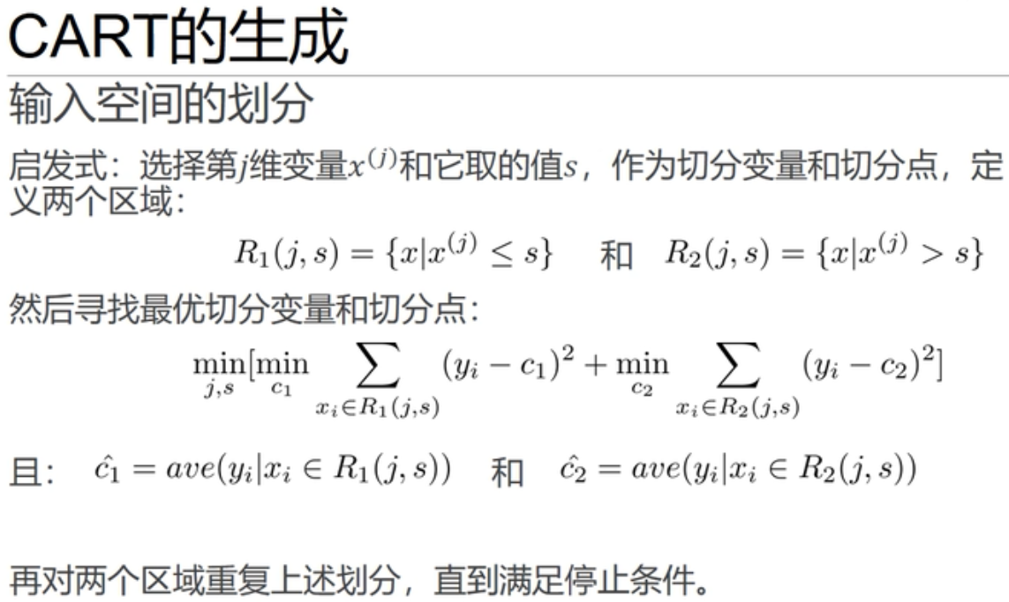

Slide 32
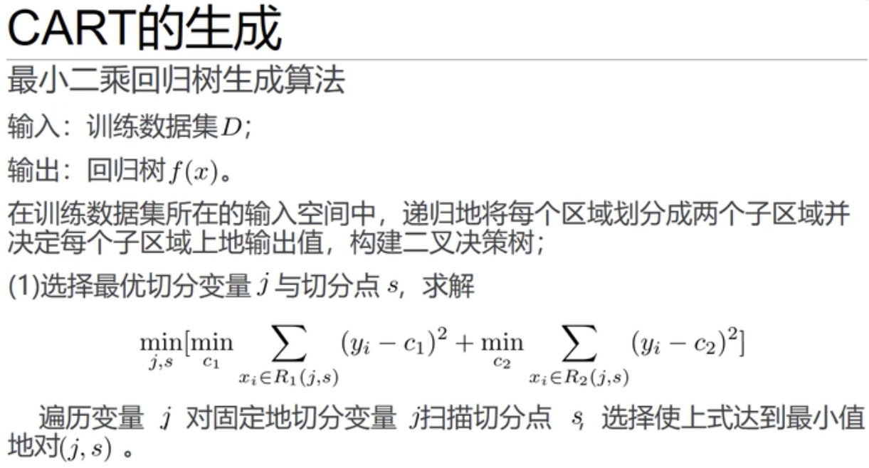

Slide 33
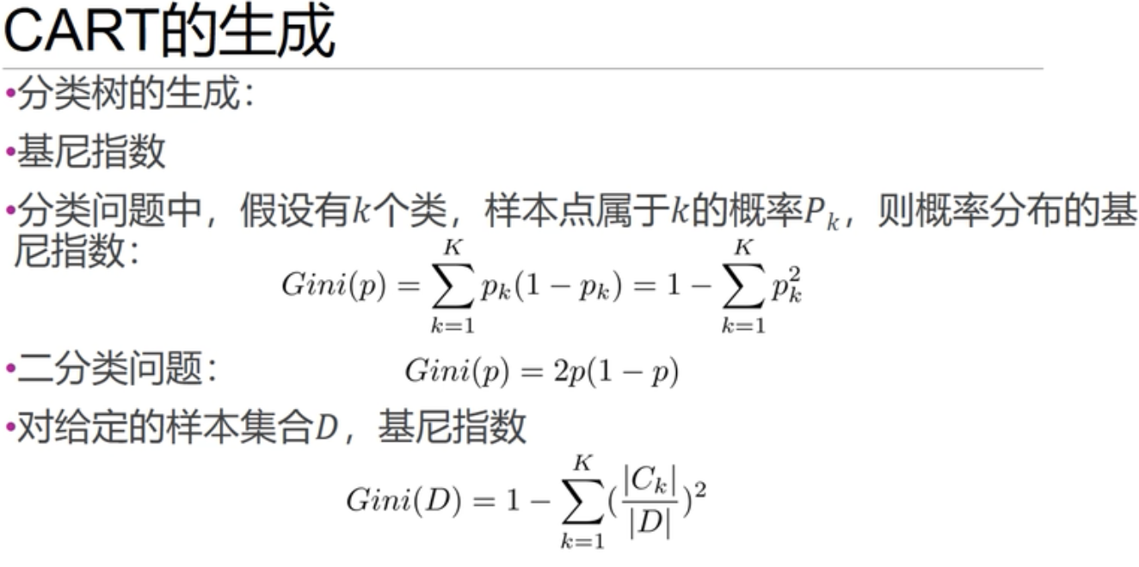
Notes:
K个类别
样本的纯度

Slide 34
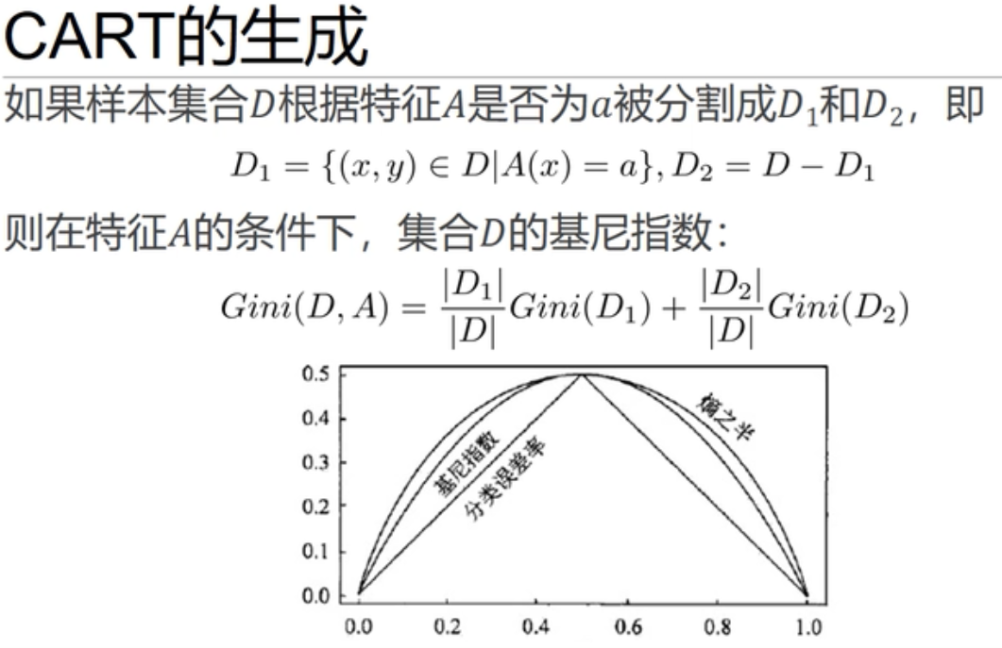

Slide 35
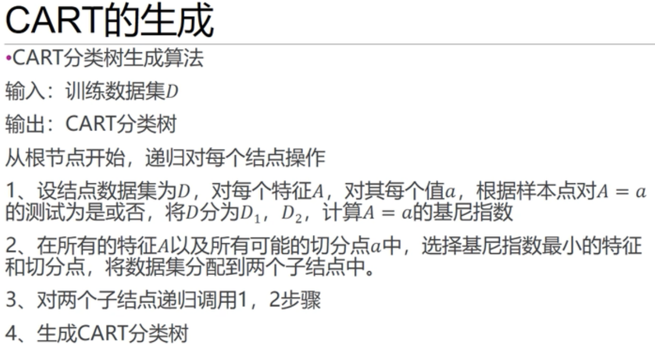

Slide 36
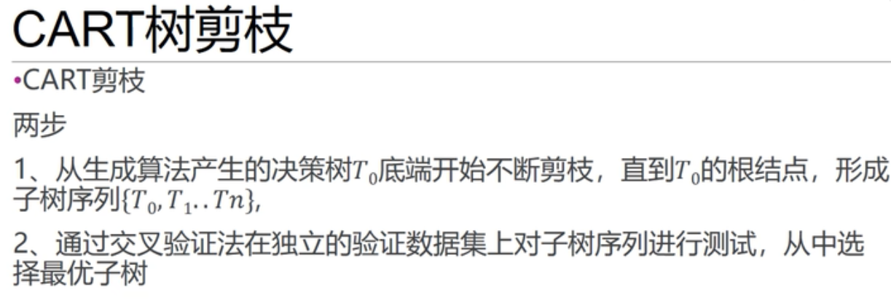

Slide 37
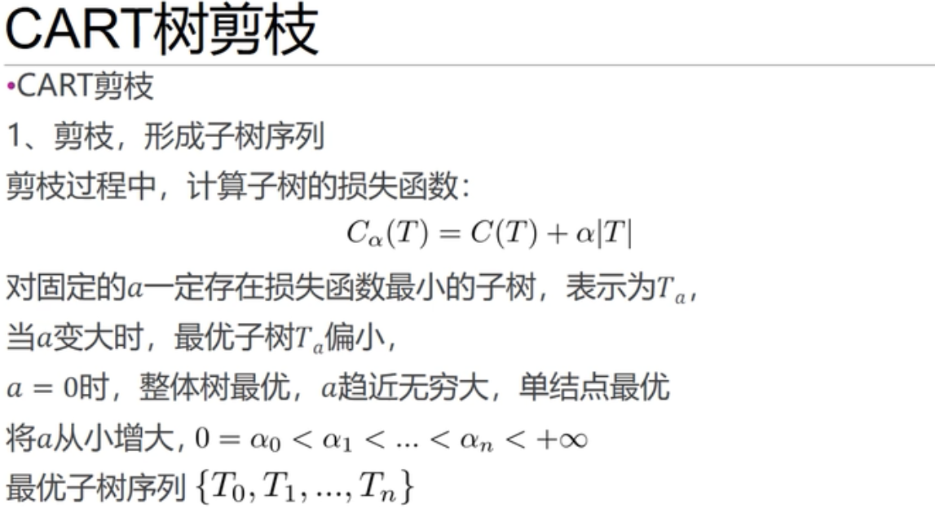

Slide 38
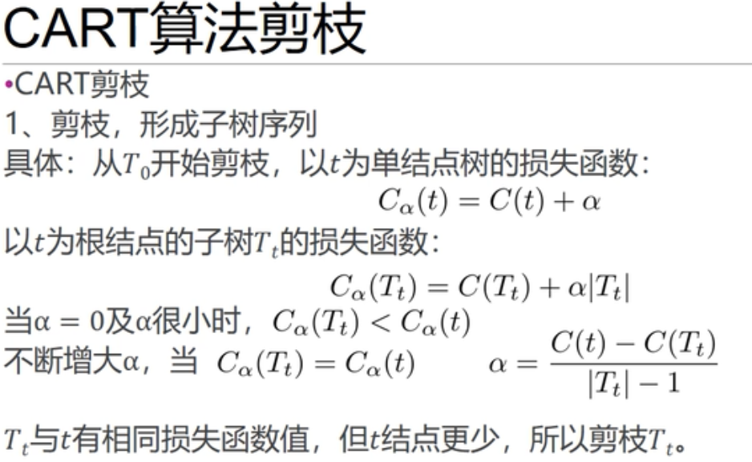

Slide 39
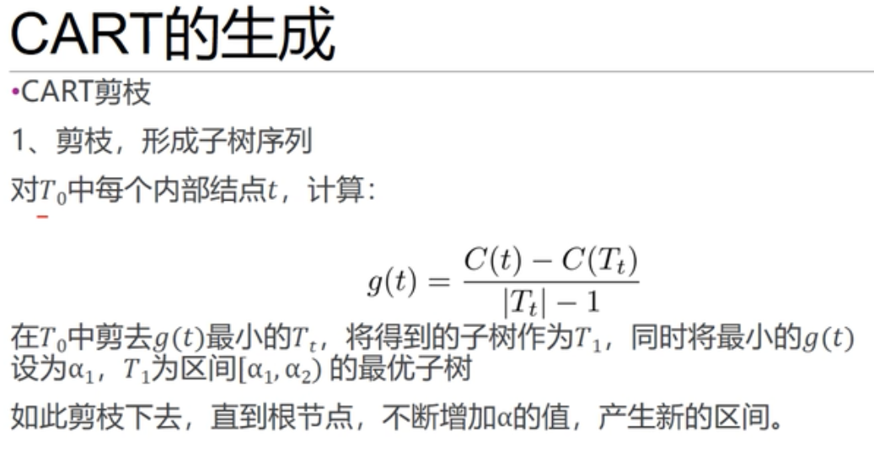

Slide 40
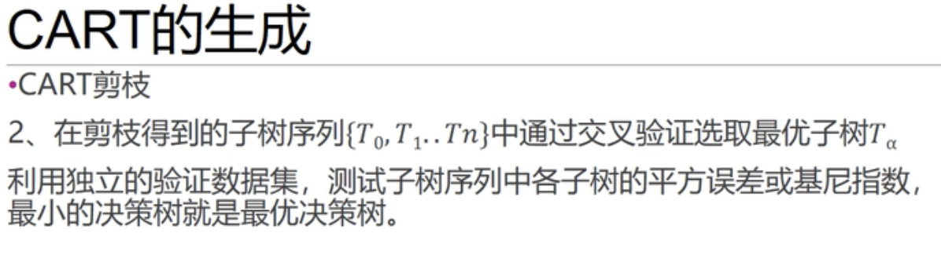

Slide 41
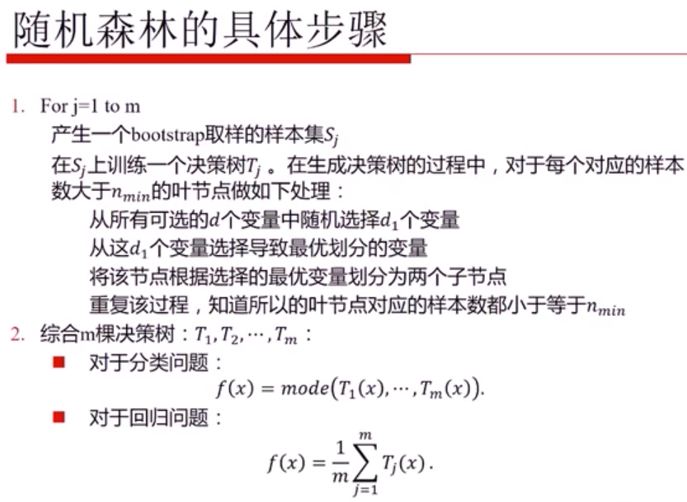
直到所有
Notes:
随机数据，随机属性

Slide 42
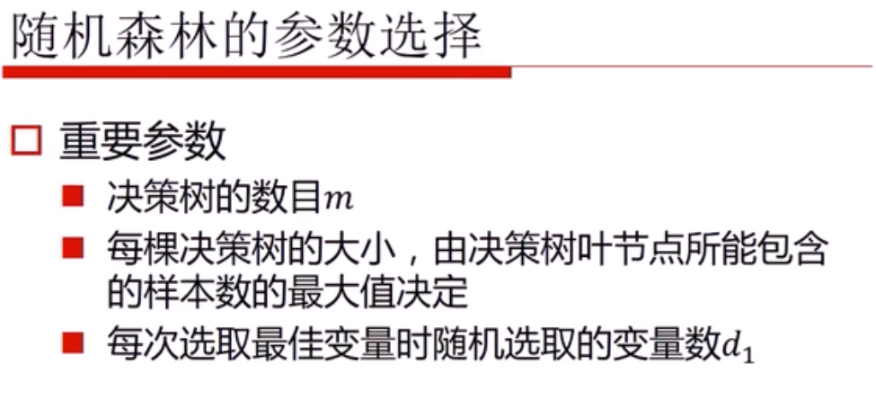

Slide 43
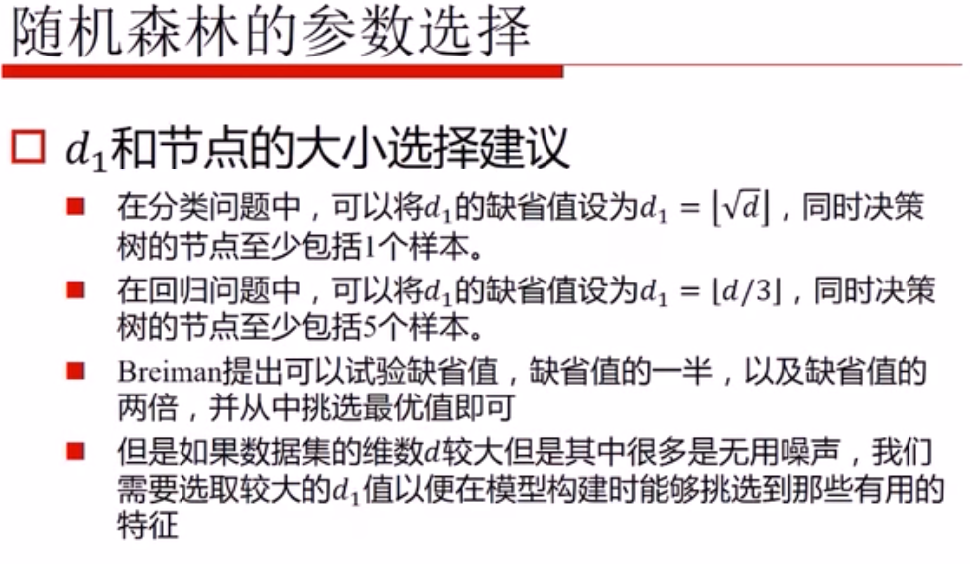

Slide 44
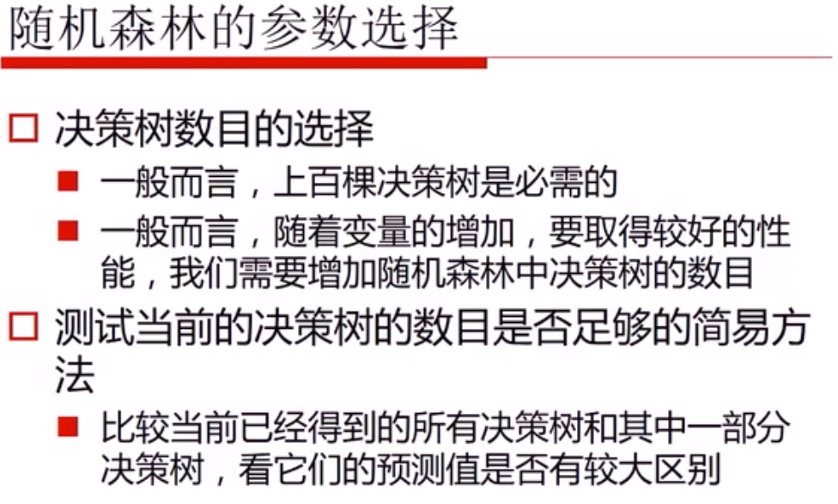

Slide 45
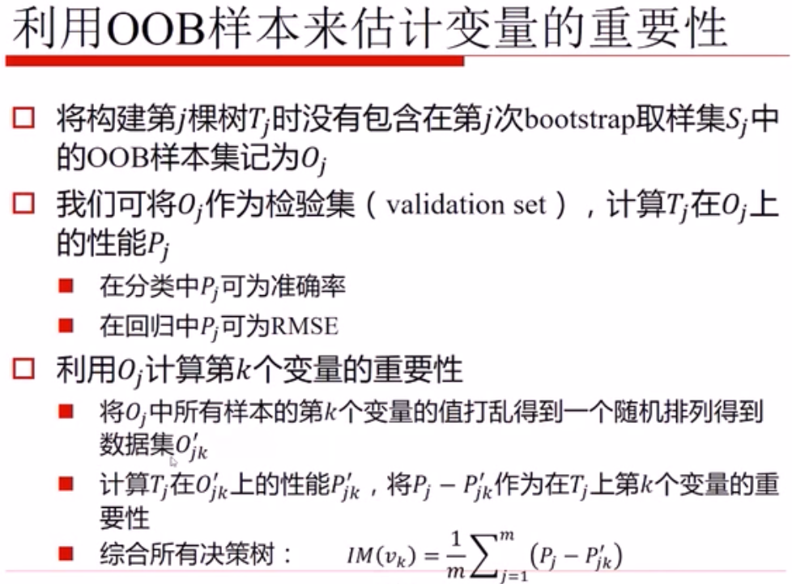
Notes:
m个变量 m个特征

Slide 46
RF Main Features
Generates substantially different trees:
Use random bootstrap samples of the training data.
Use random subsets of variables for each node.
Number of Variables
Square Root (K)
K: total number of available variables
Can dramatically speed up the tree building process.
Number of Trees
500 or more
Self-Testing
Around one third of the original data are left out.
Out of Bag (OOB)
Similar to Cross-Validation
Notes:
每次取 Square Root (K) 个属性

Slide 47
RF Advantages
All data can be used in the training process.
No need to leave some data for testing.
No need to do conventional cross-validation.
Data in OOB are used to evaluate the current tree.
Performance of the entire RF
Each data point is tested over a subset of trees.
Depends on whether it is in the OOB.
High levels of predictive accuracy
Only a few parameters to experiment with.
Suitable for both classification and regression.
Resistant to overtraining (overfitting).
No need for prior feature selection.
Notes:
Out of Bag (OOB)
不用剪枝
resistant英[rɪˈzɪstənt]美[rɪˈzɪstənt]
adj.抵抗的; 有抵抗力的; 抵制的; 阻止的; 抗…的; 耐…的;

Slide 48
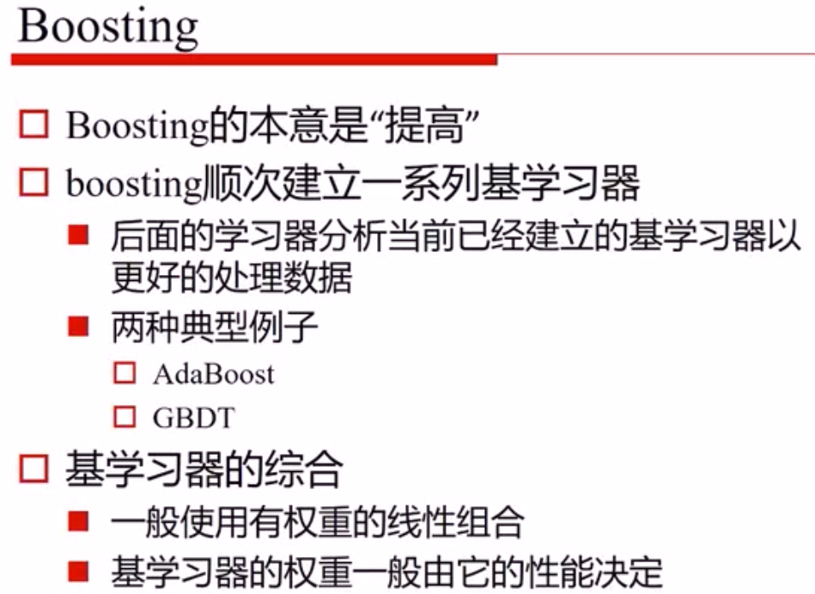

Slide 49
Boosting
Base classifier h₁(x)
Base classifier
h₂(x)
Base classifier
h_{T}(x)
Training
Boosting classifier
H(x) = sign(∑α_{i}h_{i}(x))
Test
Results

Slide 50
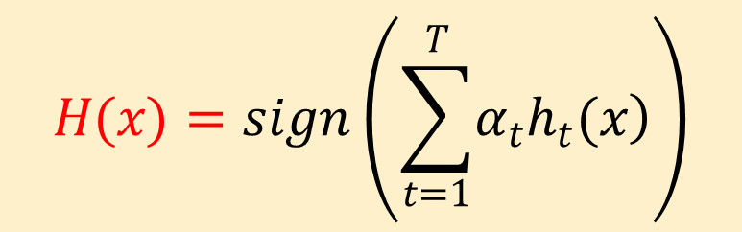
AdaBoost
分类器训练
--单个弱分类器
.
.
.
强分类器
弱分类器

Slide 51
AdaBoost
分类器训练
--单个弱分类器
弱分类器 1

Slide 52
AdaBoost
分类器训练
--单个弱分类器
增加权重

Slide 53
AdaBoost
分类器训练
--单个弱分类器
弱分类器2

Slide 54
AdaBoost
分类器训练
--单个弱分类器
增加权重

Slide 55
AdaBoost
分类器训练
--单个弱分类器
弱分类器3

Slide 56
AdaBoost
分类器训练
--单个弱分类器
最终的分类器是由很多个弱分类器线性组合而成

Slide 57
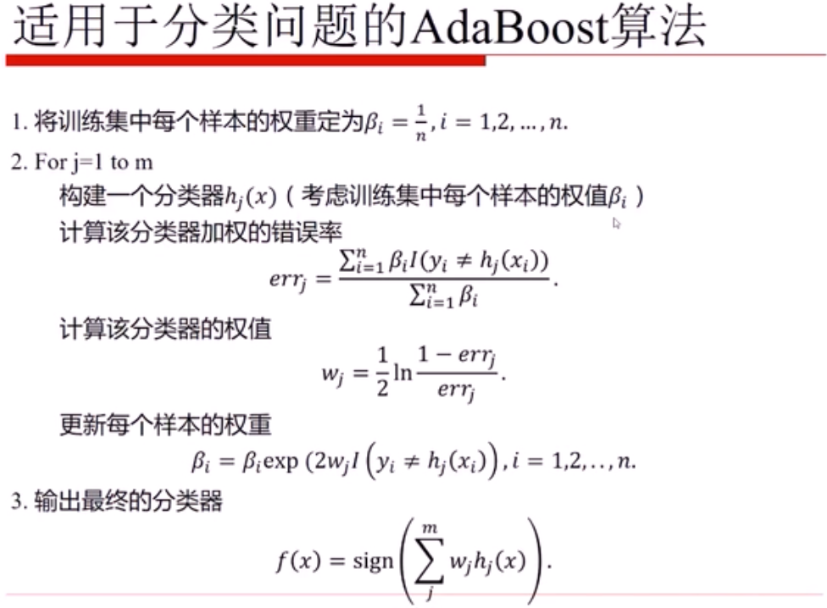
Notes:
err大于50%，则扔掉改弱分类器
alpha 和 omega 是指同一个权重

Slide 58
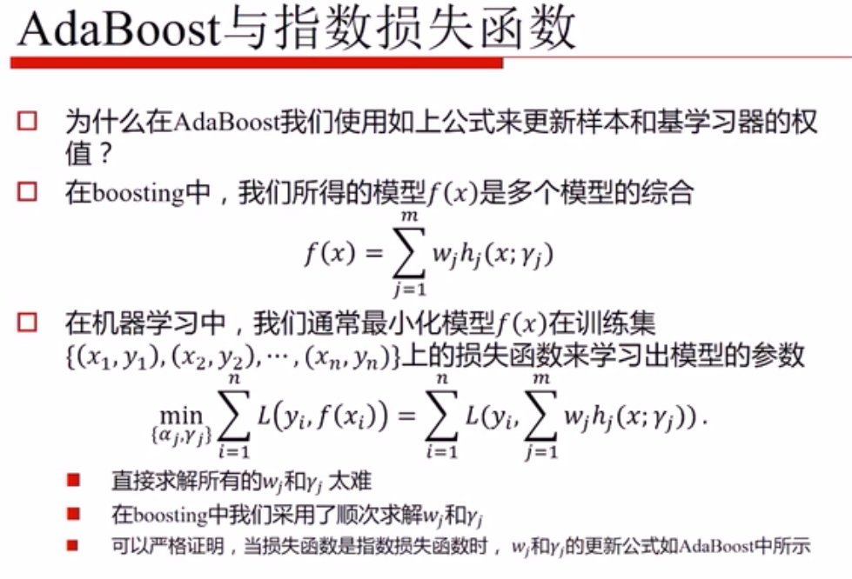
Notes:
Adaboost 等价于 最小化指数损失函数
alpha 和 omega 是指同一个权重

Slide 59
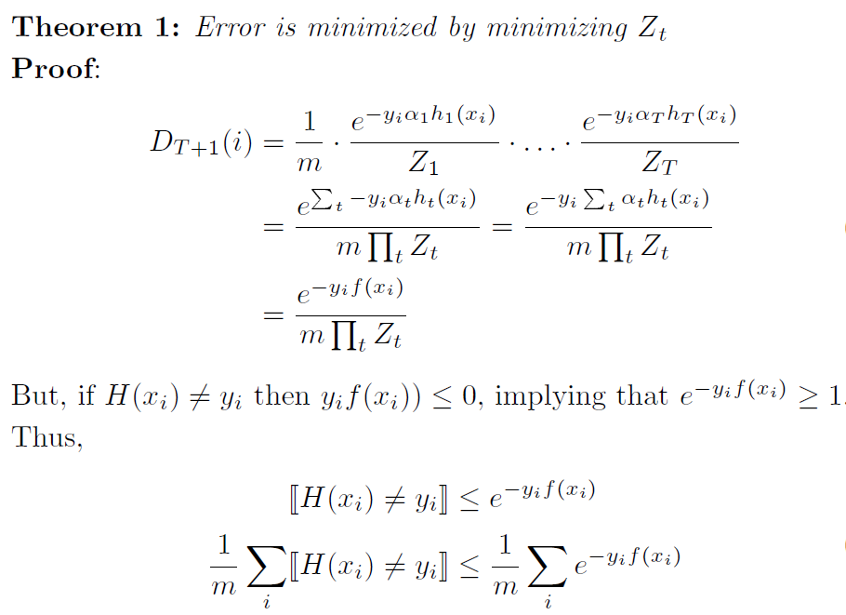
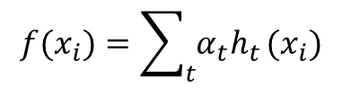
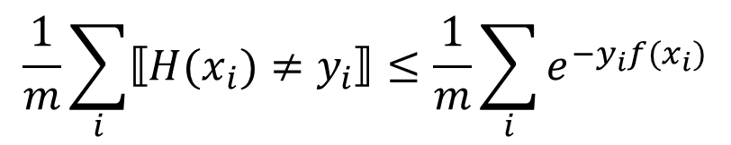
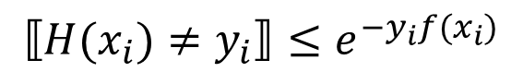
The Choice of α
$$f(x_{i})=\sum_{t}{α_{t}h_{t}}(x_{i})$$
$$H\left(x_{i}\right)≠y_{i}⇒y_{i}f\left(x_{i}\right)≤0⇒e^{−y_{i}f\left(x_{i}\right)}≥1$$
$$⟦H(x_{i})≠y_{i}⟧≤e^{−y_{i}f(x_{i})}$$
$$\frac{1}{m}\sum_{i}{⟦H(x_{i})≠y_{i}⟧≤\frac{1}{m}\sum_{i}{e^{−y_{i}f(x_{i})}}}$$
Model Error
Notes:
alpha 和 omega 是指同一个权重

Slide 60
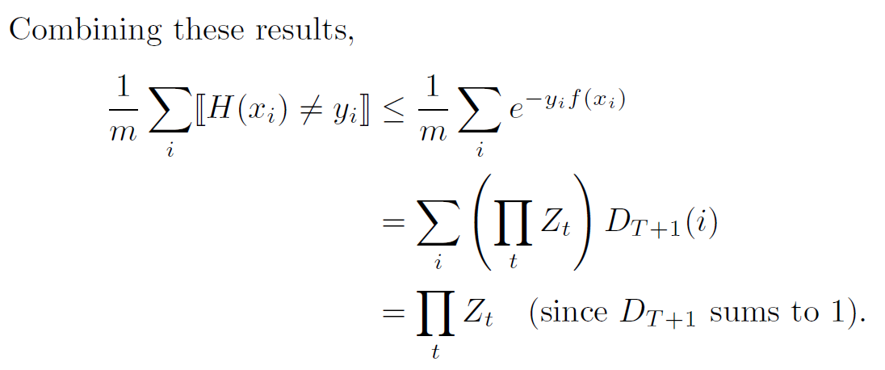
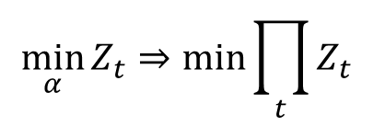

The Choice of α
$$D_{T+1}\left(i\right)=\frac{e^{−y_{i}^{}f(x_{i})}}{m\prod_{t}{Z_{t}}}$$
$$\min_{α}{Z_{t}⇒\min_{}{\prod_{t}{Z_{t}}}}$$

Slide 61



The Choice of α
$$y, h(x)∈\left\{−1,+1\right\}$$
$$Z=\sum_{i}{D_{i}e^{−αy_{i}h(x_{i})}}$$
$$\frac{∂Z}{∂α}=−e^{−α}\sum_{i}{D_{i}P\left(y_{i}=h\left(x_{i}\right)\right)+e^{α}\sum_{i}{D_{i}P\left(y_{i}≠h\left(x_{i}\right)\right)=0}}$$

Slide 62








Error Bounds
$$r=\sum_{i}{D_{i}y_{i}h\left(x_{i}\right)}$$
$$ε=\frac{1−r}{2}$$
$$α=\frac{1}{2}\ln{\frac{1+r}{1−r}}$$
$$Z=\sum_{i}{D_{i}e^{−αy_{i}h(x_{i})}}=\sum_{i}{D_{i}e^{−(\frac{1}{2}\ln{\frac{1+r}{1−r}})y_{i}h(x_{i})}}=\sum_{i}{D_{i}{\left(\sqrt{\frac{1+r}{1−r}}\right)}^{−y_{i}h(x_{i})}}$$
$$=\sum_{i}{D_{i}\left(\sqrt{\frac{1+r}{1−r}}P\left(y_{i}≠h\left(x_{i}\right)\right)+\sqrt{\frac{1−r}{1+r}}P\left(y_{i}=h\left(x_{i}\right)\right)\right)}$$
$$=\sqrt{\frac{1+r}{1−r}}ε+\sqrt{\frac{1−r}{1+r}}\left(1−ε\right)=\frac{1}{1−r}\sqrt{1−r^{2}}\frac{1−r}{2}+\frac{1}{1+r}\sqrt{1−r^{2}}\frac{1+r}{2}$$
$$=\sqrt{1−r^{2}}$$
$$\frac{1}{m}⟦H(x_{i})≠y_{i}⟧≤\prod_{t}{Z_{t}}=\prod_{t}{\sqrt{1−{r_{t}}^{2}}}$$
Notes:
误差上界，趋近于零

Slide 63

Summary of AdaBoost
Advantages
Simple and easy to implement
Almost no parameters to tune
Proven upper bounds on training set
Immune to overfitting
Disadvantages
Suboptimal $α$ values
Steepest descent
Sensitive to noise

Slide 64


Slide 65


Slide 66


Stacking
Learner
Learner
h₁(x_{i})
C₁
h₂(x_{i})
C₂
C
y_{i}
…
Train
Train
h_{k}(x_{i})
C_{k}
D
Base Classifiers
Meta Classifier
$$\left\{\left(x_{1},y_{1}\right)…(x_{n},y_{n})\right\}$$
$$\left\{\left(h_{1}\left(x_{i}\right),h_{2}\left(x_{i}\right),…,h_{k}\left(x_{i}\right),y_{i}\right)\right\}$$

Slide 67

Stacking

Slide 68


Slide 69


Slide 70


Slide 71


Slide 72

如何

Slide 73


